Slide 1



The Global Multi-Hub Network
Service, questions and problems
4D4Life Meeting, 16-18 February, Faro, Portugal

Slide 2
Aims
Point out questions and problems, which occurred during preparation of the Multi Hub Concept
Analysis of questionaires

Slide 3
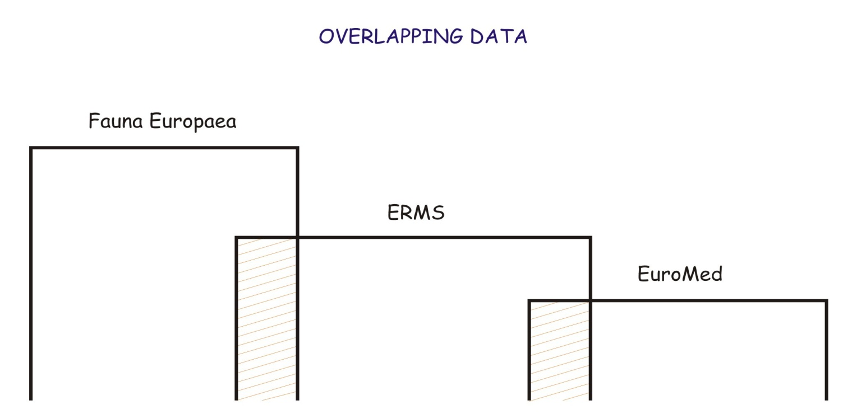
Overlapping
Internal overlapping
- CoL already contains multiple entries

Slide 4
Geographical boundaries
Definition of geographical boundaries (degree of detail of recorded (cashed) locality, continent, country, site
Identify countries occupying more then one continent
Solved in WP3 TDWG level 3,4 and ISO

Slide 5
Extra-boundary species
Extra-boundary species occurrence of Asian Plants in European Greek Islands

Slide 6
Unified style checklist for regions
Preparation of stabile structure for checklist for regional hubs (Preparation CoL based database structures for future Regional Hubs)
Taxonomies
Synonyms
Structure for geographical identifiers (names of localities)

Slide 7
Synonyms
Meaning and depth of synonym searches
More synonyms required

Slide 8
Differences and unification of regional taxonomies

Slide 9
Types of queries (Booleans) (queries based on master list)

Slide 10
Queries
queries based on presence x absence of the taxon in CoL
Queries based on presence x absence of the taxon in the master list (gathered from nomenclators)

Slide 11
Master lists
Useful for cleaning data
Useful for our knowledge what is missing in CoL
Problem – floating names or trees

Slide 12
Questionnaires preliminary analysis
Generally data cleaning, common names, providing statistical data
Requirements for currency of updates is very variable from one week to one year updates
Multilingual interface - useful
Providing INTEGRATED REGIONAL database - priority in most of the partners
Foundation of regional centres, new GSDs, mirroring usually connected with additional funding
Data sharing usually no problem except in New Zealand

